Slide 1
Mini Project Submitted By
EC-1307
DATA COMMUNICATION AND NETWORKING
Application Layer
Roshan Thakur (1714116) Varchasva Bhardwaj (1714117) Saransh Kumar (1714118) Prashant Jha (1714119)

Slide 2
MAIN TOPICS COVERED
Application Protocol Design
Application Layer Protocols
HTTP (Hypertext Transfer Protocol)
DNS (Domain Name System)
FTP (File Transfer Protocol)
SMTP (Simple Mail Transfer Protocol)
SNMP (Simple Network Management Protocol)
WWW (World Wide Web)
Summary
References

Slide 3
APPLICATION PROTOCOL DESIGN
Think of different people/teams working on the client and server programs.
Different programming languages.
Diverse hardware and operating systems.
Be unambiguous, precise.
Consider potential sources of error.
Allow for future extensions.
Leave room for additional data, meta-data like checksum
Do not replicate services provided by lower layer protocols

Slide 4
APPLICATION LAYER PROTOCOLS
An application layer protocol defines how application processes (clients and servers), running on different end systems, pass messages to each other.
In particular, an application layer protocol defines:
The types of messages like request messages and response messages
The syntax of the various message types, i.e. the fields in the message and how the fields are delineated
The semantics of the fields i.e. the meaning of the information that the field is supposed to contain
Rules for determining when and how a process sends messages and responds to messages.

Slide 5
CONTINUED..
Many Internet application-layer protocols are fully specified in Request For Comments documents (RFCs) and are therefore in the public domain.
For example, the HTTP 1.1 specification is included in RFC 2068, which was finalized and made public in January 1997.
If a browser (HTTP client) developer follows the rules of the HTTP
1.1 RFC, the browser will be able to retrieve Web pages from any Web server that has also has followed the rules of the HTTP 1.1 RFC.

Slide 6
Types of Application Layer Protocols
Application layer protocols are as follows:
DNS (Domain Name System)
HTTP (Hypertext Transfer Protocol)
SMTP (Simple Mail Transfer Protocol)
SNMP (Simple Network Management Protocol)
FTP (File Transfer Protocol)
WWW (World Wide Web)

Slide 7
DNS
HOSTNAMES:
IP address includes information used for routing.
IP addresses are tough for humans to remember or guess.
The Domain Name System:
The domain name system is usually used to translate a host name into an IP address.
Domain names comprise a hierarchy so that names are unique,
yet easy to remember.

Slide 8
CONTINUED..
Host name structure:
Each host name is made up of a sequence of labels separated by
periods.
Each label can be up to 63 characters
The total name can be of at most 255 characters.
Examples: whitehouse.gov, monica.cs.rpi.edu etc
Domain Name
The domain name for a host is the sequence of labels that lead from the host (leaf node in the naming tree) to the top of the worldwide naming tree.
A domain is a subtree of the world wide naming tree.

Slide 9
CONTINUED..
Top level domains:
edu, gov, com, net, org, mil, …
All countries have a top level domain (2 letter domain name)
New top level domains include: .aero, .biz, .coop, .info, .name, .pro etc
DNS Organization
Distributed Database
The organization that owns a domain name is responsible for running a DNS server that can provide the mapping between hostnames within the domain to IP addresses.
So some machine run by RPI is responsible for everything within
the rpi.edu domain.

Slide 10
CONTINUED..
DNS Clients:
A DNS client is called a resolver.
A call to getByName (host) is handled by a resolver.
Most Unix workstations have the file /etc/resolv.conf that contains the local domain and the addresses of DNS servers for that domain.
Nslookup:
Nslookup is an interactive resolver that allows the user to communicate directly with a DNS server.
Nslookup is usually available on Unix workstations.

Slide 11
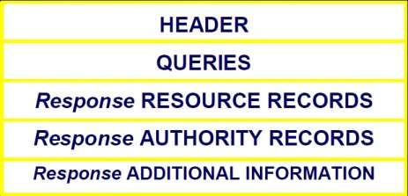
CONTINUED..
DNS Servers:
Servers handle requests for their domain directly.
Servers handle requests for other domains by contacting remote DNS server(s).
Servers cache external mappings.
DNS Message Format:

Slide 12
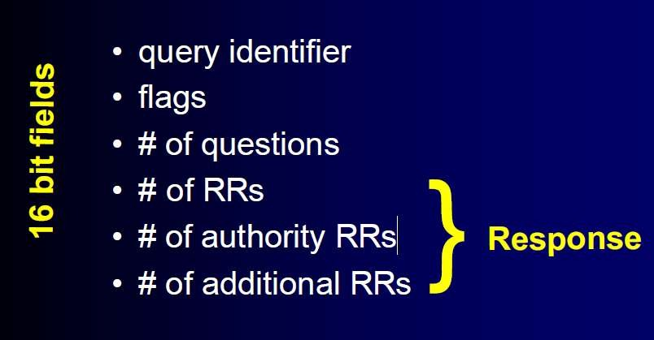
CONTINUED..
DNS Message Header:

Slide 13
INTRODUCTION TO HTTP
HTTP has been in use by the World-Wide Web global information initiative since 1990.
Protocol used for communication between web browsers (clients) and web servers.
Popular Web servers:
Apache HTTPD
JBoss
Tomcat
Popular Web clients:
Firefox
Opera

Slide 14
IMPORTANCE OF HTTP
Understand the interaction between web clients and web servers
Manually query web servers and receive low-level information that typical web browsers hide from the user
Understand the configuration and capabilities of a particular server
Debug configuration errors with the server or programming errors in programs invoked by the web server
Streamline web services to make better use of the protocol.

Slide 15
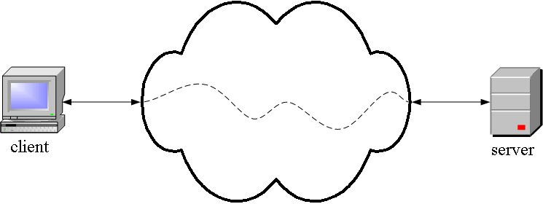
HTTP IS AN APPLICATION LAYER PROTOCOL
The Web client and the Web server are application programs
Application layer programs do useful work like retrieving Web pages, sending and receiving email or transferring files
Lower layers take care of the communication details
The client and server send messages and data without knowing anything about the communication network

Slide 16
URLS, URNS AND URIS
Every resource accessible through HTTP is identified by a Uniform Resource Location (URL), which is a location-specific identifier.
Example: http://www.cs.uct.ac.za:80/
A Uniform Resource Identifier (URI) is a standard format
(<scheme>:<identifier>) generic identifier.
Example: mailto:hussein@cs.uct.ac.za
A Uniform Resource Name (URN) is one example of a location-independent URI.
Example: urn:isbn:123-456-789
Note: Every URL and URN is also a URI!

Slide 17
OTHER HTTP FEATURES
Authentication
Persistent connections
GET-if-modified
Byte ranges
Content type negotiation
Cache control
Proxy support

Slide 18
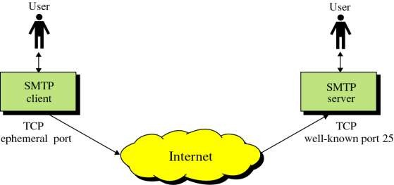
SIMPLE MAIL TRANSFER PROTOCOL (SMTP)
This protocol originated in 1982 (RFC821, Jon Postel)
Standard message format (RFC822,2822, D. Crocker)
The objective was to transfer mail reliably and efficiently

Slide 19
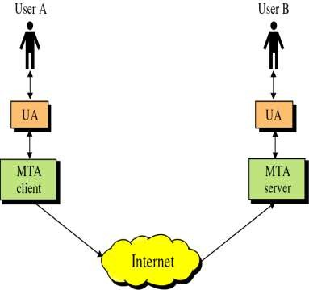
CONTINUED..
SMTP clients and servers have two
main components:
User Agents – Prepares the message, encloses it in an envelope. (ex. Thunderbird, Eudora)
Mail Transfer Agent – Transfers the mail across the internet (ex. Sendmail, Exim)
Analogous to the postal system in many ways

Slide 20
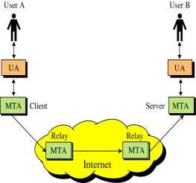
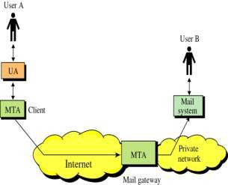
CONTINUED..
SMTP also allows the use of Relays allowing other MTAs to relay the mail.
Mail Gateways are used to relay mail prepared by a protocol other than SMTP and convert it to SMTP.

Slide 21
INTRODUCTION TO SNMP
What is SNMP?
SNMP Architecture
SNMP Components

Slide 22
WHAT IS SNMP?
Simple Network Management Protocol (SNMP) is an Internet standard protocol.
It is defined by IETF, Internet Engineering Task Force. It is an application layer protocol.
It manages devices on IP networks. Devices that typically support SNMP include routers, switches, servers, workstations, printers, modem racks and more. It is used mostly in network management.
SNMP is an application program that allows manager to retrieve value of an object defined in agent, a manager to store value in an object defined in agent, an agent to send alarm information called trap event.
○

Slide 23
SNMP ARCHITECTURE
○ Manager
○ Agent
○ NMS(Network Management Systems)

Slide 24
SNMP ARCHITECTURE
○ SNMP defines the manager and its monitored and managed devices connected to the network.
○ The manager sends request to network device called agent and agent responds to manager request via SNMP.
○ Agents will respond data on managed systems as variables.

Slide 25
SNMP ARCHITECTURE
NMS, network management system executes application which monitor and manage devices. Basically it runs on the manager

Slide 26
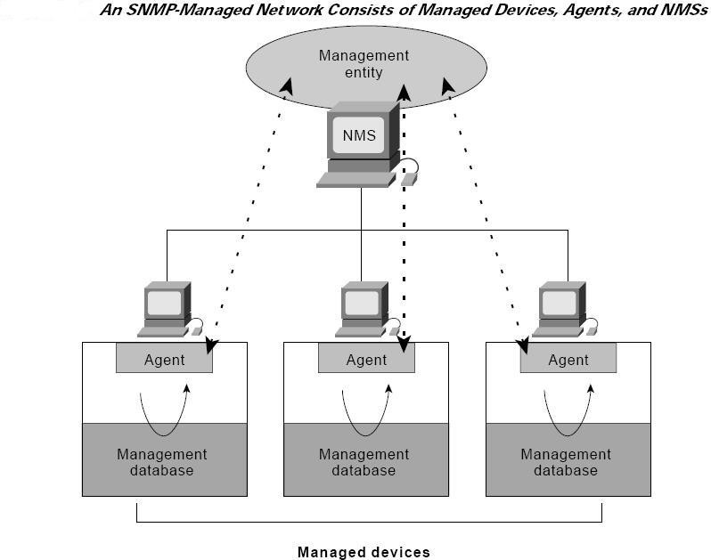

Slide 27
SNMP COMPONENTS
○ Management information base (MIB)
○ Structure of management information (SMI)

Slide 28
○ SNMP provides information about devices and that variable’s information is provided by Management Information Base (MIB). It is a collection of objects and their types in hierarchical tree format.
MIB

Slide 29
SMI
SMI defines the rule for naming objects, defining object types and showing how to encode objects and data.
It manages devices on IP networks. Devices that typically support SNMP include routers, switches, servers, workstations, printers, modem racks and more. It is used mostly in network management.
SNMP is an application program that allows the manager to retrieve value of an object defined in agent, a manager to store value in an object defined in agent, an agent to send alarm information called trap event.

Slide 30
SENDING MESSAGES TO SMTP SERVER
E-mail communication using Relaying
Used during initial days of SMTP.
SMTP routing information is included along with E-mail address.
Problem with this method.
Using DNS
This method is used at present.
The sender’s SMTP server makes the use of DNS to find MX record of the domain to which the E-mail is to be sent.

Slide 31
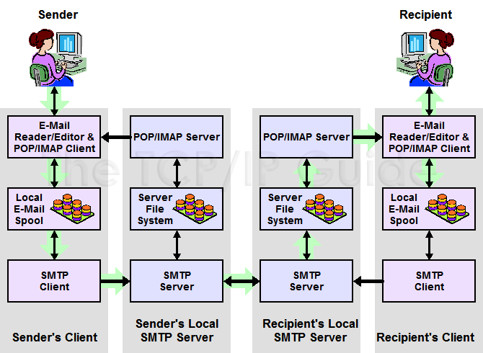
SMTP COMMUNICATION MODEL

Slide 32
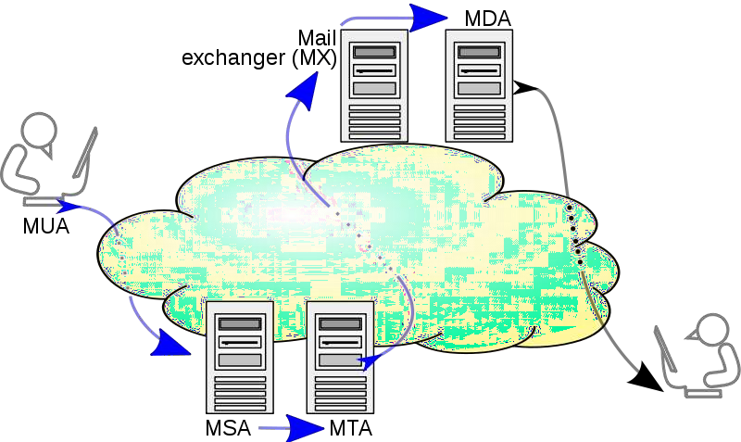
MAIL PROCESSING MODEL

Slide 33
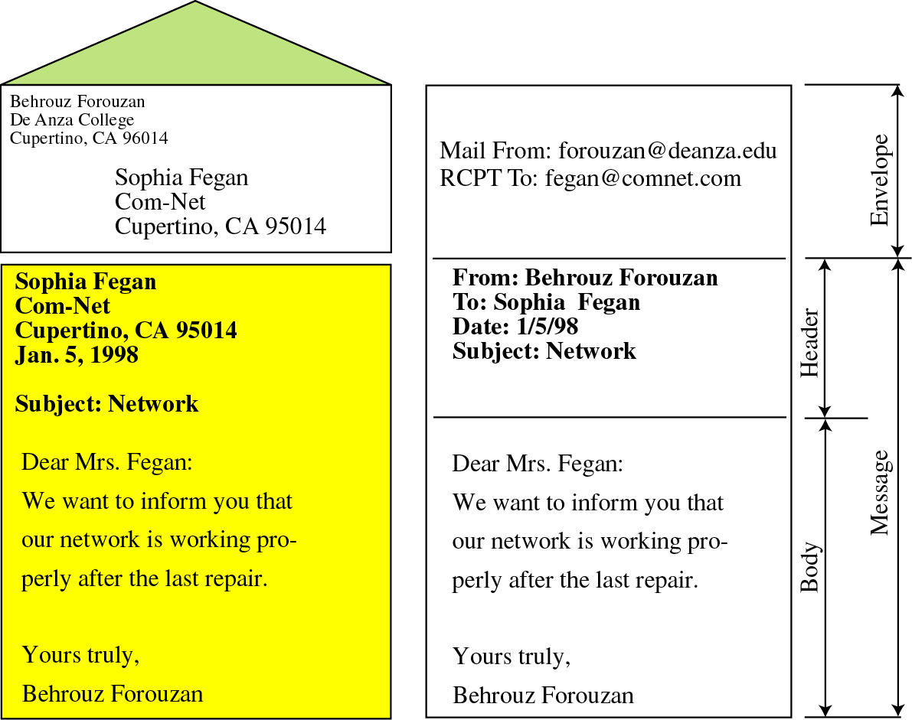
🞤 Sender’s address
🞤 Receiver’s address
🞤 Other information
🞭 Message –
🞤 Mail Header – defines the sender, the receiver, the subject of the message and other information
🞤 Mail Body – Contains the actual information in the message

Slide 34
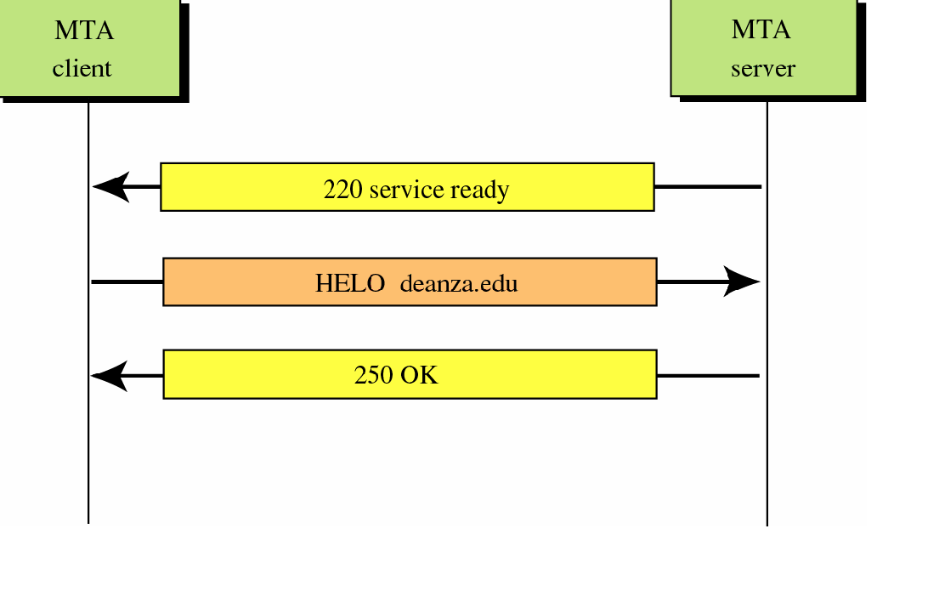
CONNECTION ESTABLISHMENT

Slide 35
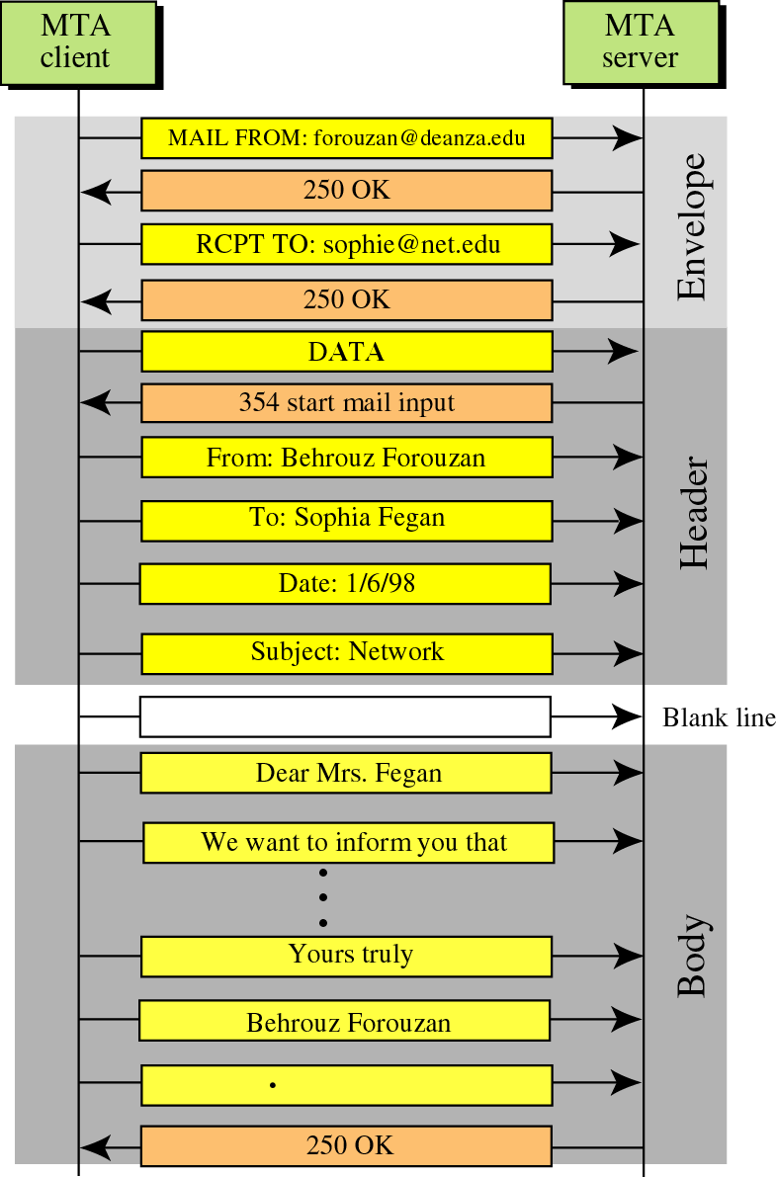
MESSAGE PROGRESS

Slide 36
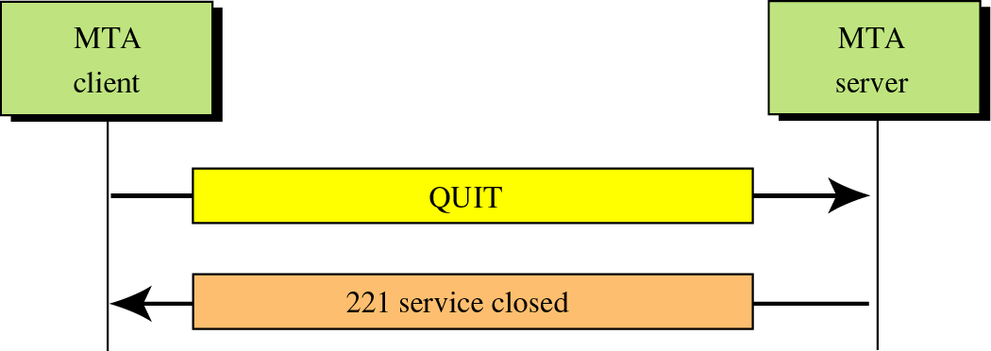
CONNECTION TERMINATION
TCP Connection Termination

Slide 37
SPECIAL FEATURES OF SMTP
🞭 Mail Forwarding: SMTP server may agree to accept e-mail for non-local mailbox and forward it to the appropriate destination.
🞭 Mail Gatewaying: SMTP servers can be implemented as e-mail gateways which can translate TCP/IP email in a suitable form for some another e-mail system and vice-versa.
🞭 Mail Relaying: SMTP includes the ability to relay mail from one server to another, as explained earlier, provided certain conditions are met.
🞭 Address Debugging: VRFY command allows the client to ask the sender to verify address of recipient without sending mail to recipient.
🞭 Mailing List Expansion: EXPN command allows to expand mailing list.

Slide 38
LIMITATIONS OF SMTP
Security matters for SMTP are worse.
Its usefulness is limited by its simplicity.
Transmission of executable files and binary files using SMTP is not possible without converting into text files. Use MIME to send mail in other format.
It cannot transmit text data that contains national language characters. These national language characters use 8-bit codes with values of 128 decimal or more.
It is limited to 7-bit ASCII characters only.
SMTP servers may reject mail messages beyond some specific length.

Slide 39
FILE TRANSFER PROTOCOL (FTP)
File Transfer Protocol (FTP) is the standard mechanism provided by TCP/IP for copying a file from one host to another over internet.
FTP is a most commonly used communication protocol for transferring the files over the internet.
FTP establishes two connections between the hosts.
One connection is used for data transfer The other for control information (commands and responses).
FTP uses two well-known TCP ports:
Port 21 is used for the control connection
Port 20 is used for the data connection.

Slide 40
FTP COMMUNICATION
Control Connection
It uses 7 bit ASCII character set.
Communication is achieved through commands and responses. It can send only one command at a time.
Each command or response is only one short line. Each line is terminated with a two-character end-of-line token.
Data Connection
File transfer occurs over the data connection under the control of the commands sent over the control connection.

Slide 41
FTP COMMANDS
The RETR command supervises copying a file from the server to the client. This is called retrieving.
The STOR command supervises copying a file from the client to the server. This is called storing.
The LIST command supervises sending of lists of directory or file names from the server to the client.

Slide 42
A FEW FEATURES OF FTP
Interactive Access:
Most implementations provide an interactive interface that allows humans to easily interact with remote servers.
Format (representation) specification:
FTP allows the client to specify the type and format of stored data.
Authentication Control:
FTP requires client to authorize themselves by sending a login name and password to the server before requesting file transfers.

Slide 43
WORLD WIDE WEB (WWW)
It was invented by Tim Berners Lee in 1989.
The World Wide Web is a medium for exchanging information between computers connected to the internet.
The network of images, texts and sounds on the internet which can be viewed using a web browser application

Slide 44
HOW THE WWW WORKS
Clients use browser application to send URIs via HTTP to servers requesting a Web page
Servers respond with the requested Web page (or with an error message in case the request cannot be completed)
Client’s browser renders the page returned by the server
The entire system runs over standard networking protocols like TCP/IP, DNS etc

Slide 45
STRUCTURAL COMPONENTS
Clients/browsers
Servers, high-performance machines which run on sophisticated hardware
Caches
Internet, the global infrastructure which facilitates data transfer

Slide 46
SEMANTIC COMPONENTS
Hyper Text Transfer Protocol (HTTP)
Hyper Text Markup Language (HTML)
eXtensible Markup Language (XML)
Uniform Resource Identifiers (URIs)

Slide 47
DIFFERENCE BETWEEN WWW AND THE INTERNET
The internet is a global network of networks, on which any two connected computers can communicate with each other.
The World Wide Web is a way of accessing information over the medium of the internet. It can be thought of as an information-sharing model that is built on top of the Internet

Slide 48
SUMMARY
The OSI model of networks has 7 layers. One of those layers is the Application Layer. The 6 protocols of the Application Layer discussed were:
DNS
HTTP
SMTP
SNMP
FTP
WWW

Slide 49
REFERENCES
Web Sites:
http://www.faqs.org/rfcs/rfc821.html (RFC 821).
http://www.faqs.org/rfcs/rfc2821.html (RFC 2821)
http://www.tcpipguide.com/free/t_SMTPSpecialFeaturesCapabilitiesandExtensions.html
http://cns.utoronto.ca/usg/technotes/smtp-intro.html
http://computer.howstuffworks.com/email5.htm
Books:
Programmer's Guide to Internet Mail by John Rhoton
TCP/IP Illustrated Volume 1 by Richard Stevens

